Slide 1


Week 06
- Normalization
Data Management & Database Design DAMG 6210
Manuel D. Montrond
Northeastern University - Graduate School of Engineering
Spring 2024

Slide 2
Objectives
Types of anomalies
Use normalization to convert anomalous tables to well-structured relations
Define first, second, and third normal form

Slide 3
Data Normalization
Primarily a tool to validate and improve a logical design so that it satisfies certain constraints that avoid unnecessary duplication of data
The process of decomposing relations with anomalies to produce smaller, well-structured relations
Notes:
Data normalization – extremely important. They will ask you about this in an interview
The whole premise of Data Normalization is to avoid unnecessary data duplication, and create well-structure relations
It must add. “It decreases the code you will have to write” The design comes to life

Slide 4
Well-Structured Relations
A relation that contains minimal data redundancy
Allows users to insert, delete, and update rows without causing data inconsistencies
Goal is to avoid anomalies related to data changes
Notes:
What do we mean by well structure relations: it avoid anomalies:
Rule of Thumb

Slide 5
Types of Anomalies
Insertion Anomaly–adding new rows forces user to create duplicate data
Deletion Anomaly–deleting rows may cause a loss of data that would be needed for other future rows
Modification Anomaly–changing data in a row forces changes to other rows because of duplication
Notes:
What do we mean by well structure relations: it avoid anomalies:
General rule of thumb: A table should not pertain to more than one entity type

Slide 6
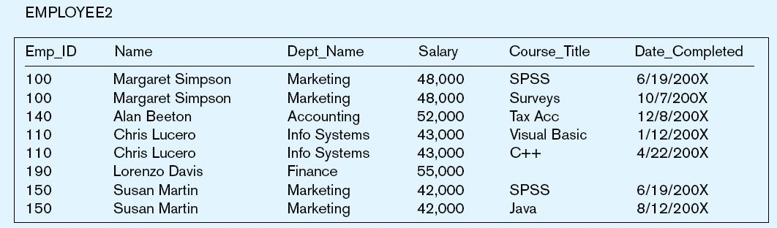
Example–Figure 5-2b
Question–Is this a relation?
Answer–Yes: Unique rows and no multivalued attributes
Question–What’s the primary key?
Answer–Composite: Emp_ID, Course_Title
Notes:
Is this a well-designed table? No.
What are some of the issue do you see with this?

Slide 7
What anomalies exists?
Notes:
Insertion–can’t enter a new employee without having the employee take a class
Deletion–if we remove employee 140, we lose information about the existence of a Tax Acc class
Modification–giving a salary increase to employee 100 forces us to update multiple records

Slide 8
Anomalies in this Table
Insertion–can’t enter a new employee without having the employee take a class
Deletion–if we remove employee 140, we lose information about the existence of a Tax Acc class
Modification–giving a salary increase to employee 100 forces us to update multiple records
Notes:
Unfortunate example like these exist in every organization.
They didn’t take this course.
Why do these anomalies exist?
Because there are two themes (entity types) in this one relation. This results in data duplication and an unnecessary dependency between the entities

Slide 9
Functional Dependencies
Functional Dependency: The value of one attribute (the determinant) determines the value of another attribute
Candidate key - unique identifier. One of the candidate keys will become the primary key
E.g. perhaps there is both credit card number and SS# in a table…in this case both are candidate keys
Each non-key field is functionally dependent on every candidate key
Notes:
How to we solve that problem.
One way to look at it this problem is through functional dependencies:
The value of one attribute depends the values of others.
Example, maybe both are unique…

Slide 10
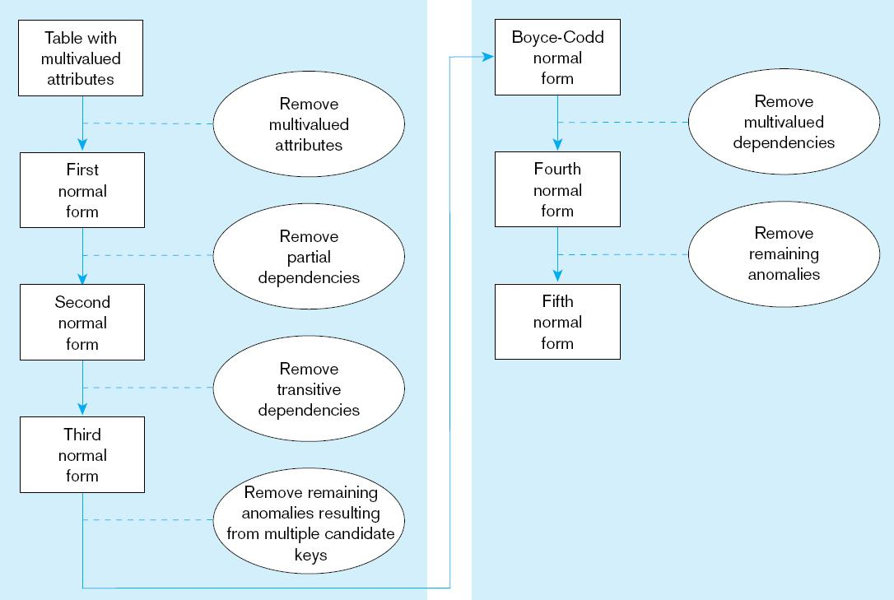
Figure 5.22 Steps in normalization
Notes:
We will go over these steps one by one.
Typically, the third normal form is what you want.

Slide 11
First Normal Form
No multivalued attributes
Every attribute value is atomic
All relations are in 1st Normal Form

Slide 12
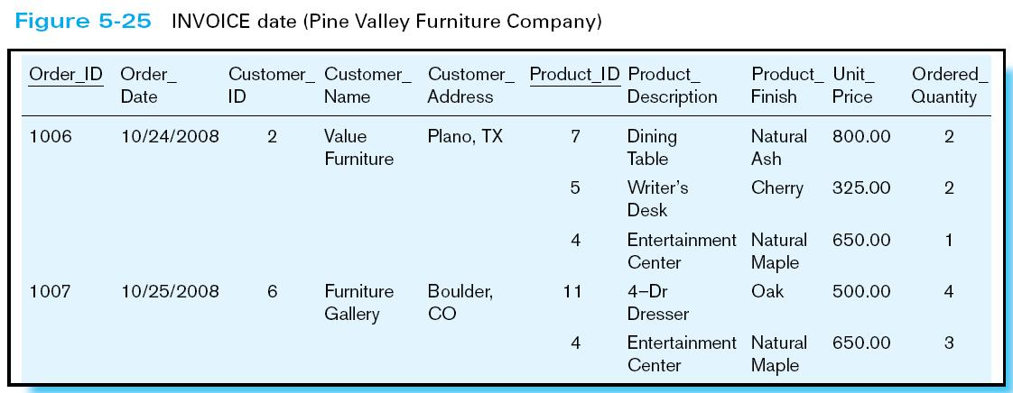
Table with multivalued attributes, not in 1st normal form
Note: this is NOT a relation
Notes:
Product information are multivalued. This isn’t a relation.

Slide 13
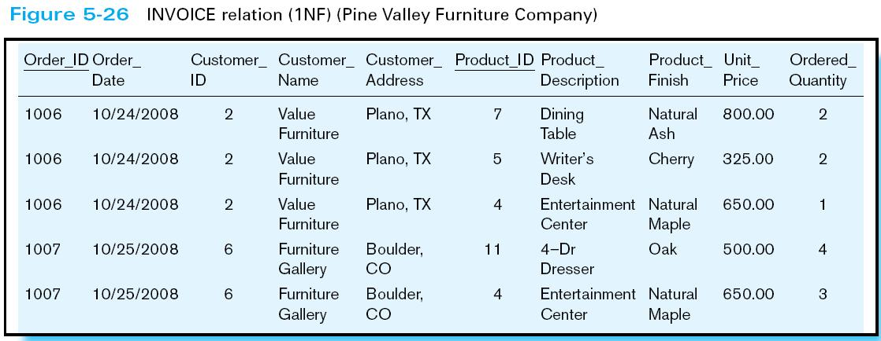
Table with no multivalued attributes and unique rows, in 1st normal form
Note: this is a relation, but not a well-structured one
Notes:
Insertion–if new product is ordered for order 1007 of existing customer, customer data must be re-entered, causing duplication
Deletion–if we delete the Dining Table from Order 1006, we lose information concerning this item's finish and price
Update–changing the price of product ID 4 requires update in several records

Slide 14
Second Normal Form
1NF PLUS every non-key attribute is fully functionally dependent on the ENTIRE primary key
Every non-key attribute must be defined by the entire key, not by only part of the key
No partial functional dependencies

Slide 15
What is the primary key?
Notes:
Order ID + ProductID

Slide 16
Create a functional dependency
Are there any partial dependency?

Slide 17
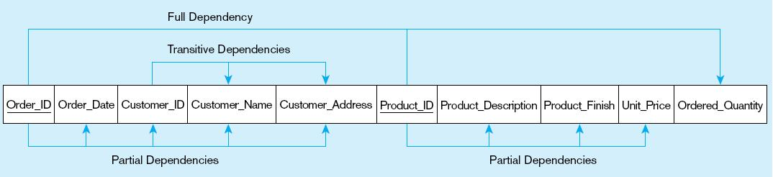
Partial Dependency
Notes:
Full dependency-> an attribute is functionally dependent of that attribute, and not on any of its proper subset
Transitive dependency-> when an indirect relationship causes functional dependency
O->C, Customer -> Customer Name
Partial dependency ->
When an attribute is dependent on part of the candidate key

Slide 18
Partial Dependency
Notes:
Full dependency-> an attribute is functionally dependent of that attribute, and not on any of its proper subset
Transitive dependency-> when an indirect relationship causes functional dependency
O->C, Customer -> Customer Name
Partial dependency ->
When an attribute is dependent on part of the candidate key

Slide 19
Partial Dependency
Therefore, NOT in 2nd Normal Form
Notes:
Full dependency-> an attribute is functionally dependent of that attribute, and not on any of its proper subset
Transitive dependency-> when an indirect relationship causes functional dependency
O->C, Customer -> Customer Name
Partial dependency ->
When an attribute is dependent on part of the candidate key

Slide 20
Remove Partial Dependency
Notes:
Full dependency-> an attribute is functionally dependent of that attribute, and not on any of its proper subset
Transitive dependency-> when an indirect relationship causes functional dependency
O->C, Customer -> Customer Name
Partial dependency ->
When an attribute is dependent on part of the candidate key

Slide 21
Remove Partial Dependency
Order_ID ➔ Order_Date, Customer_ID, Customer_Name, Customer_Address
Notes:
Full dependency-> an attribute is functionally dependent of that attribute, and not on any of its proper subset
Transitive dependency-> when an indirect relationship causes functional dependency
O->C, Customer -> Customer Name
Partial dependency ->
When an attribute is dependent on part of the candidate key

Slide 22
Remove Partial Dependency
Order_ID ➔ Order_Date, Customer_ID, Customer_Name, Customer_Address
Product_ID ➔ Product_Description, Product_Finish, Unit_Price
Order_ID, Product_ID ➔ Order_Quantity
Notes:
Full dependency-> an attribute is functionally dependent of that attribute, and not on any of its proper subset
Transitive dependency-> when an indirect relationship causes functional dependency
O->C, Customer -> Customer Name
Partial dependency ->
When an attribute is dependent on part of the candidate key

Slide 23
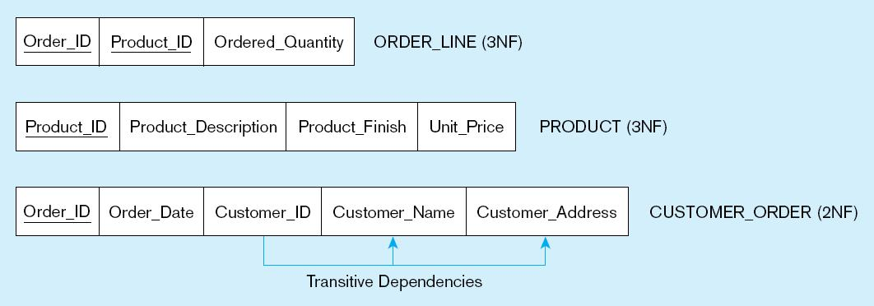
After Removing partial dependencies
Partial dependencies are removed, Therefore it is now in 2nd Normal Form
Now in Second Normal Form

Slide 24
Third Normal Form
2NF PLUS no transitive dependencies (functional dependencies on non-primary-key attributes)
Note: This is called transitive, because the primary key is a determinant for another attribute, which in turn is a determinant for a third
Solution: Non-key determinant with transitive dependencies go into a new table; non-key determinant becomes primary key in the new table and stays as foreign key in the old table

Slide 25
Any transitive dependency?

Slide 26
Remove Transitive Dependencies
Getting it into Third Normal Form

Slide 27
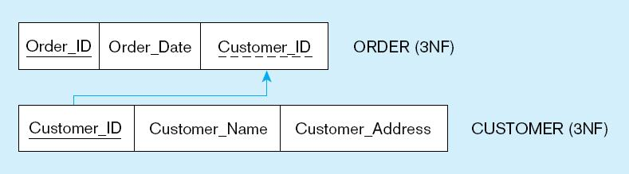
Removing Transitive dependencies
Transitive dependencies are removed
Now in Third Normal Form

Slide 28
Normalization Summary
1NF - First Normal Form means each attribute is atomic! No repeating groups
2NF - Second Normal Form means every non-key attribute is dependent on the entire primary key ( simple or composite)
3NF - Third Normal Form means that every non-key attribute is dependent only on the key, that is, there are no transitive dependencies !
“The key, the whole key, and nothing but the key.”

Slide 29
Typical Interview Question
Question: How do you normalize your database in a operational/ transactional environment, and describe the normalization steps?
Transactional systems are typically normalized in the 3NF:
1FN – remove multi value attributes
2NF – remove partial dependencies
3NF – remove transitive dependencies
That questions pertains only to transactional system. In Datawarehouse, analytical systems you don’t normalize

Slide 30
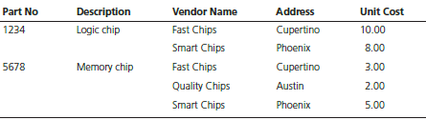
Table below contains sample data for parts and for vendors who supply those parts. In discussing these data with users, we find that part numbers (but not descriptions) uniquely identify parts and that vendor names uniquely identify vendors.
a)Draw a relational schema for PART SUPPLIER and show the functional dependencies.
b. In what normal form is this relation?
c. Develop a set of 3NF relations from PART SUPPLIER.
Notes:
Problem 7

Slide 31
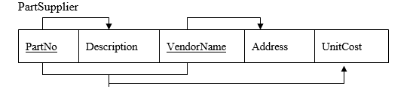
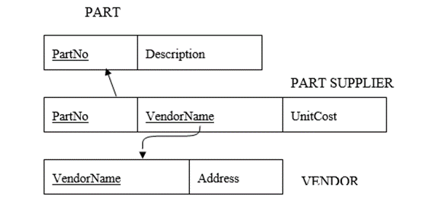
Solution
a)
b) Not a relation
c)

Slide 32
References
Google Image
Modern Database Management 13th Edition ( Hoffer, Ramesh, Topi)

